Slide 1
Related Work +
First Experiment
September 25, 2026
Notes:
Shared class deck. Slides 2–3 contain instructions; teams duplicate slides 4–9 and append their completed slides. The bracketed prompts are intentional editable template fields. Based on Kostis's September 18 update and slides 2–6 of Project Pitches.

Slide 2
Updates + Next steps
Next week (10/2): NO CLASS
(10/9): Present experiment results (for compute resources message Georgios and myself on Slack)
After that: Some weeks progress reports, some weeks student presentations about their comprehensive related work, some weeks instruct presentations.

Slide 3
TODOs: September 25
Copy and paste slides 4-9 at the end of this presentation with your own material.
Related work / baselines (5 minutes)
Identify 4–5 closely related papers, choose the strongest 1–2 and explain why.
First experiment (5 minutes)
Propose ONE experiment: question, comparison, and expected learning.
Duplicate slides 4–9, fill in your answers, and append them to this deck.
October 2: no class.
October 9: present experiment results.

Slide 4
Present your work clearly
Decide who presents each part and plan the handoffs.
Explain your points naturally and avoid reading from notes.
Look at the audience, not the screen.
Practice your part 4–5 times before class.
Stay within time! (5+5 minutes)

Slide 5
[#]: [Project title]
[Team members]

Slide 6
1. Closest related work
Identify 4–5 papers. For each: citation/link, relevance, and baseline potential.
[Paper 1: citation/link, what is it about (very briefly), closest connection, possible baseline]
[Paper 2: citation/link, what is it about (very briefly), closest connection, possible baseline]
…

Slide 7
2. Strongest baseline(s): why these?
Choose the strongest 1–2 papers from your shortlist.
Why are they the closest and strongest comparisons?
What can each do today? What limitation matters to your project?
What will you compare directly against each baseline?

Slide 8
3. First experiment: question + claim
What ONE question will this experiment answer?
State the claim or hypothesis before running anything.
Is the problem real, and how large is the gap?
What result would make you reconsider the project?

Slide 9
4. First experiment: setup
Some questions to answer:
What system or approach will you test?
What is the strongest reasonable baseline?
What real or realistic workload/data will you use?
What will you vary, hold fixed, and measure?
How will you keep the experiment small and automate it?

Slide 10
5. Expected figure + what we learn
Prepare the planned figure:
Sketch the planned figure, label axes, units, and comparisons.
What pattern would support your hypothesis?
What outcome would surprise you or challenge your claim?
What will you learn, and what would you do next?
[Remember: For September 25: propose the experiment + one result (i.e. one column, line, subplot, etc.). You want to have the complete figure by October 9.

Slide 11
18: Cost-Efficient Search for Agentic Workflows with Retries
Thomas Ajai, Junzhe Zong, Kangyuan Ding,
Tianjun Feng, Alehsan Aliyev

Slide 12
1. Closest related work
- AgentOpt compares multiple search algorithms for non-retry-aware multi-stage agent pipelines, efficiently identifying model combinations that balance task performance, cost, and latency through a user-defined multi-objective utility rather than exhaustively evaluating every configuration.
- VineLM reduces the cost of optimizing agent workflows by modelinSCOPE searches for cost-efficient model assignments in compound AI systems under a target quality constraint. It selectively evaluates promising configurations and prunes candidates that are unlikely to satisfy the constraint or improve deployment cost per-invocation model choices as an execution trie and reusing shared prefixes through checkpointing and sparse profiling.
- SCOPE searches for cost-efficient model assignments in compound AI systems under a target quality constraint. It selectively evaluates promising configurations and prunes candidates that are unlikely to satisfy the constraint or improve deployment cost.
- Gittin Eval treats configuration evaluation as a cost-aware Bayesian bandit, using a Gittins index to choose the next configuration and proposed an uncertainty-aware anytime recommendation rule to early stop.
- SySRs reduces search cost by exploiting performance correlations across models, allowing evaluation measurements to be shared across similar model arms to prune weak candidates early.
Notes:
Anastasis

Slide 13
2. Strongest baseline(s): why these?
Choose the strongest 1–2 papers from your shortlist.
Why are they the closest and strongest comparisons?
What can each do today? What limitation matters to your project?
What will you compare directly against each baseline?

Slide 14
Baseline 1: Matrix UCB-E (AgentOpt)
Matrix UCB-E treating each complete assignment of models to workflow stages as a candidate arm.
  Why relevant: because it aims to find a near-optimal workflow configuration under a limited profiling budget.
  Across four benchmarks, it achieved near-optimal accuracy while using 62%-76% fewer evaluations than exhaustive search.
Matrix UCB-E adaptively allocates evaluation samples according to each combination’s estimated performance and uncertainty.
  It evaluates uncertain but potentially competitive combinations more extensively.
  It eliminates effort on configurations that appear unlikely to be optimal.
  It provides a strong flat-search baseline without relying on retry-specific structure.
Relevant Limitations:
  It treats complete configurations as independent arms, even when retry configurations share the same models and execution prefix.
  It does not model early success, conditional retry reachability, or outcome-dependent execution cost.
  Its allocation is driven mainly by statistical uncertainty rather than the actual incremental cost of executing later retries.

Slide 15
Baseline 2: GittinsEval
GittinsEval is the strongest cost-aware Bayesian baseline, jointly considering estimated configuration quality, posterior uncertainty, and evaluation cost.
  It is especially relevant because it decides both which configuration to evaluate next and when sufficient evidence has been collected to stop.
  It also provides an adaptive stopping rule.
GittinsEval models each configuration as a Bayesian bandit arm and assigns it a Gittins-style priority index.
  Promising, uncertain, and inexpensive configurations receive higher evaluation priority.
  It produces an anytime recommendation and supports adaptive stopping instead of requiring a fixed profiling budget.
  It is therefore a strong cost-aware search baseline for measuring budget-to-convergence.
Relevant Limitations:
  It uses configuration-level costs and does not explicitly model whether later retry attempts will actually be reached.
  It cannot reuse observations across configurations with shared execution prefixes.
Comparison against Both Baselines:
  Represent every complete retry policy as one arm for Matrix UCB-E and GittinsEval, while our method explicitly models retry attempts and shared prefixes.
  Use the same candidate configurations, benchmark questions, warm-up samples, random seeds, and realized dollar budget.
  Compare held-out accuracy, simple regret, and the profiling budget required to reach and consistently retain an ε-optimal configuration.
  Measure the percentage of budget saved before convergence and the deployment cost of the selected configuration.
  This determines whether retry-aware reachability, prefix reuse, and adaptive stopping improve over both flat uncertainty-based search and flat cost-aware Bayesian search.

Slide 16
3. First experiment: question + claim
Can a search method find a good sequence with fewer evaluations?
Hypothesis: Adaptive search (Matrix UCB-E) will find a solver sequence with near-best final accuracy using less profiling money than random search.
The size of the problem: Three solver models across three possible attempts give 27 sequences. Since this is still small enough to test exhaustively, we can know the true best sequence and measure how quickly search gets close to it.
Result that would change our direction: If random search finds equally good sequences at the same profiling budget, we may not need a specialized search method.

Slide 17
4. First experiment: setup
System: A solver answers MathQA questions; a fixed verifier can request up to two retries. Each solver attempt has its own model choice.
Search comparison: Compare AgentOpt’s Matrix UCB-E with random search at the same profiling cost. Exhaustive evaluation of the small search space gives a reference best sequence.
Data: Use labeled MathQA questions for search and separate questions to evaluate the selected sequence.
Vary and hold fixed: Vary the solver sequence and search method; keep the verifier, prompts, and retry rule fixed.
Measure: Plot the selected sequence’s accuracy gap from the reference best against profiling dollars; also report deployment cost, latency, and retry count.
Keep it small: Three solver models give 27 sequences. Record each attempt and score final answers automatically.

Slide 18
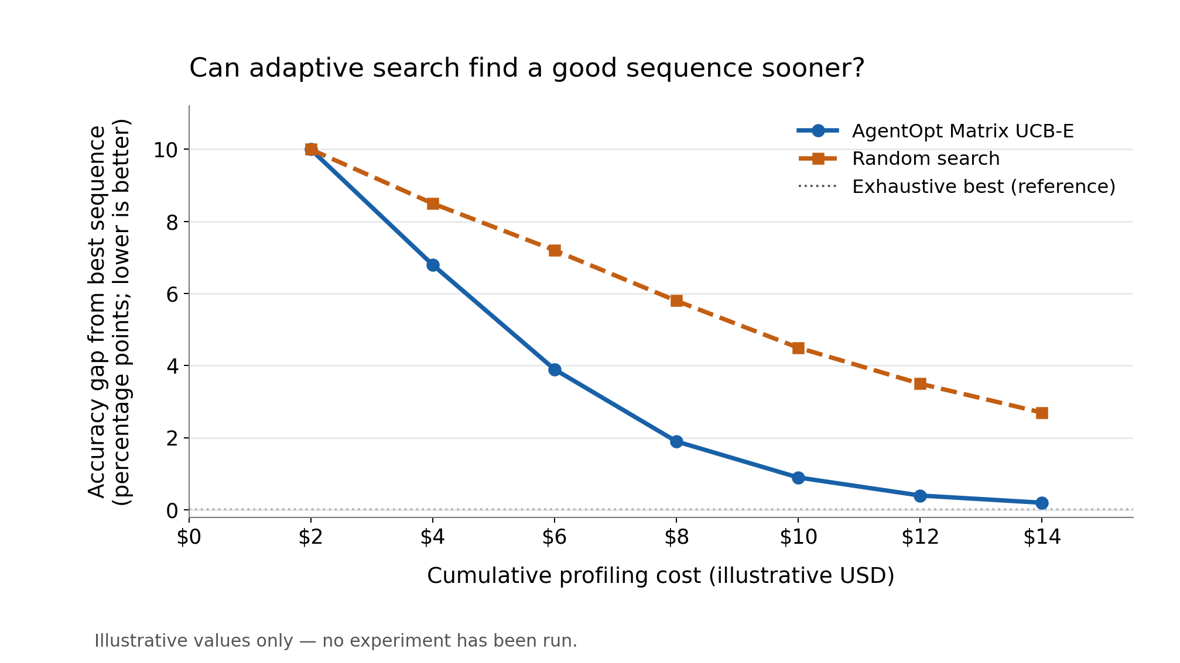
5. Expected figure + what we learn
Planned figure: A line chart with cumulative profiling cost (USD) on the x-axis and accuracy gap from the exhaustively evaluated best sequence (percentage points; lower is better) on the y-axis. Plot AgentOpt Matrix UCB-E and random search, with a horizontal zero-gap reference line.
Supports our hypothesis: Matrix UCB-E reaches a small accuracy gap at substantially lower profiling cost than random search.
Challenges our hypothesis: Random search matches or beats Matrix UCB-E, or most solver sequences perform almost identically.
What we learn next: If adaptive search helps, investigate how retry frequency and evaluation cost can guide it; if it does not, use the simpler method and examine why the sequences are hard to distinguish.

